Slide 1
Survey analysis week 42 “ratio and regression estimation”
© Peter Lugtig
11-10-2021: Lecture is too long. Need an actual ratio example.
Last bit: restructure
.
Notes:
Notes after lecture: 30-10-2017
Too many scenarios 1,3 and 5.
The regression example doesn’t really work. Make it more complex
Lets sample some outliers with the data to make it more real-life
Also, lets overdo the floor and ceiling effects a bit, so that it is clearer why regression doesn’t work.
Lets just do scenarios 5,

Slide 2
Today
Why ratio estimation?
Class exercise ratio estimation
New example: coffees at UU
Lecture ratio and regression estimation
Class exercise regression estimation
Your dataset and svydesign settings

Slide 3
Why ratio estimation?
We know:
The size of each farm in the USA
N_{h} and n_{h}
Estimate from a sample:
What crops they produce
What is their yield per acre (or total production)
USA wheat production = wheat production per acre * total # acres of wheat
Auxiliary information at level of farm

Slide 4
Why ratio estimation?
We know:
How many schools there are: # schools
N_{h} (no. of clusters)
Estimate from a sample:
The average number of children per school: n_{h}
the proportion with reading problems: p
Total # children with learning diff = n_{h} * N_{h}* pchildren with reading problems or
Auxiliary information at level of cluster

Slide 5
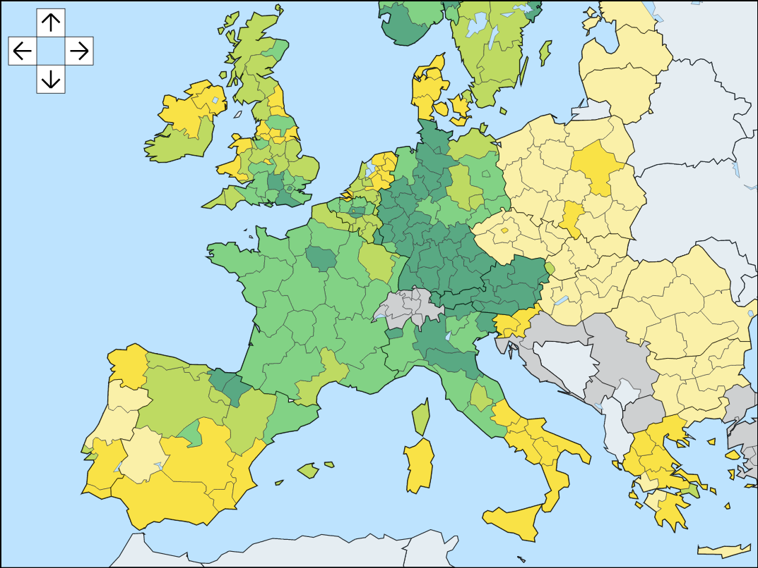
Why so often in cluster samples?
We often don’t know much about individuals
But we do know about the clusters
Public sources:
Population size
income, employment
Gender, age distribution
Etc.
Is Y strongly correlated with these?
And a ratio variable?
Ratio estimation
E.g. No. of births, marriages, death

Slide 6
Class exercise 1
25 minutes
4 short questions…

Slide 7
A more complex example: estimation in 2-stage cluster sampling
More realistic
Time coffee machines in Ruppert take to make coffee
Use cluster sampling (select 1). What is population mean?
We can at most sample 2 machines, and get 10 coffees
How can we estimate the mean time it will take someone to get a coffee?
1 minute in pairs
 | 1 | 2 | 3 | 4 | 5 | 6 | 7
Machine 1
Machine 2
Machine 3
Machine 4

Slide 8
Example: 2 clusters (m) of size (n) 2 Some data
Time coffee machines in Ruppert take to make coffee
Use cluster sampling (select 1). What is population mean?
What is estimate of mean(time) for someone to get a coffee?
 | 1 | 2 | 3 | 4 | 5 | 6 | 7
Machine 1 | 20 | 20 | 19 | 21 | 20
Machine 2 | 22 | 23 | 22 | 22 | 21
Machine 3
Machine 4

Slide 9
Example: 2 clusters (m) of size (n) 2 Some data
 | 1 | 2 | 3 | 4 | 5 | 6 | 7
Machine 1 | 20 | 20 | 19 | 21 | 20
Machine 2 | 22 | 23 | 22 | 22 | 21
Machine 3
Machine 4
Use cluster sampling (select 1). What is population mean?
What is estimate of Mean(time) for someone to get a coffee?
Equal cluster size -> SRS -> mean = 21
4/2* 210. total=420. Mean = total/20 = 21

Slide 10
example: Why equal cluster sizes?
What is the size of each cluster?
Use cluster sampling (select 1). What is population mean?
What is estimate of Mean(time) for someone to get a coffee?
1 minute in pairs
 | 1 | 2 | 3 | 4 | 5 | 6 | 7
Machine 1 | 20 | 21 | 21 | 20 | 20 | 19 | 19
Machine 2 | 22 | 23 | 21
Machine 3
Machine 4

Slide 11
We are running to the limits of design based inference
 | 1 | 2 | 3 | 4 | 5 | 6 | 7
Machine 1 | 20 | 21 | 21 | 20 | 20 | 19 | 19
Machine 2 | 22 | 23 | 21
Machine 3
Machine 4
Use cluster sampling (select 1). What is population mean?
We can still compute mean -> 20 + 22 = 21!
There are effects on standard errors of course…
Possible solutions:
Ratio estimation not possible, there is no ratio…
sample from every cluster instead of just 2 (i.e. do SRS!)
get Mi (ssu in each PSU).
Or switch to model-based estimation

Slide 12
Example: model based inference
Time coffee machines in Ruppert take to make coffee
Use cluster sampling (select 1). What is population mean?
What can our model be like?
2 minutes (in pairs)
 | 1 | 2 | 3 | 4 | 5 | 6 | 7
Machine 1 | 20 | 21 | 21 | 20 | 20 | 19 | 19
Machine 2 | 22 | 23 | 21
Machine 3
Machine 4

Slide 13
Example: model based inference
Time coffee machines in Ruppert take to make coffee
Use cluster sampling (select 1). What is population mean?
What can our model be like?
Assumptions about machine use (size of M_{i})
Use a model with auxiliary data
 | 1 | 2 | 3 | 4 | 5 | 6 | 7
Machine 1 | 20 | 21 | 21 | 20 | 20 | 19 | 19
Machine 2 | 22 | 23 | 21
Machine 3
Machine 4

Slide 14
How to design a model?
Model-based approach:
Get extra information
Imagine, we know that with each year machines get older, they become slower
Build a model (regression-based estimation)

Slide 15
Example: model assisted inference
Time coffee machines in Ruppert take to make coffee
What can our model be like?
Assumptions about machine use (size of M_{i})
Use a model with auxiliary data (this is up to the modeler)
E.g. T_{i}=M_{i}*μ + B₁*AGE_{i}*M_{i}
What is the mean? (2 minutes)
 | Age | 1 | 2 | 3 | 4 | 5 | 6 | 7
Machine 1 | 1 | 20 | 21 | 21 | 20 | 20 | 19 | 19
Machine 2 | 3 | 22 | 23 | 21
Machine 3 | 3
Machine 4 | 5

Slide 16
Example: model-assisted inference
Time coffee machines in Ruppert take to make coffee
Use cluster sampling (select 1). What is population mean?
Use a model with auxiliary data (this is up to the modeler)
Still assumptions about M_{i}
Mean: M₁: 20, M₂: 22, M₃: 22, M₄: 24
Overall: 22
Age may not even be available for machine 3 and 4 (tricky!)
 | Age | 1 | 2 | 3 | 4 | 5 | 6 | 7
Machine 1 | 1 | 20 | 21 | 21 | 20 | 20 | 19 | 19
Machine 2 | 3 | 22 | 23 | 21
Machine 3 | 3
Machine 4 | 5

Slide 17
Why the two approaches? 2-stage cluster sample with unequal cluster sizes
Design-based inference
You need to know M_{i}, N_{i}
You often don’t
Alternative is inference using the information you have
Model-based inference is easier
You use the information you have to design a model for the information you don’t have
Ratio estimation is a particular technique based on regression
It is model assisted: can be used under design-based models
e.g. Assume that the ratio t_{i}/m_{i} = the same for every M_{i}
e.g. Assume that variances are equal across clusters

Slide 18
To finalize…
Time coffee machines in Ruppert take to make coffee
Use cluster sampling (select 1). What is population mean?
Now, we can both do
Design based inference?
Model based inference?
Exercise: Do both! (2 minutes)
 | Age | Mi | 1 | 2 | 3 | 4 | 5 | 6 | 7
Machine 1 | 1 | 100 | 20 | 21 | 21 | 20 | 20 | 19 | 19
Machine 2 | 3 | 50 | 22 | 23 | 21
Machine 3 | 3 | 200
Machine 4 | 5 | 100

Slide 19
To finalize…
Time coffee machines in Ruppert take to make coffee
Use cluster sampling (select 1). What is population mean?
Design based:
(20*100 + 22*50)/150 = 20.66
 | Age | Mi | 1 | 2 | 3 | 4 | 5 | 6 | 7
Machine 1 | 1 | 100 | 20 | 21 | 21 | 20 | 20 | 19 | 19
Machine 2 | 3 | 50 | 22 | 23 | 21
Machine 3 | 3 | 200
Machine 4 | 5 | 100

Slide 20
To finalize…
 | Age | Mi | 1 | 2 | 3 | 4 | 5 | 6 | 7
Machine 1 | 1 | 100 | 20 | 21 | 21 | 20 | 20 | 19 | 19
Machine 2 | 3 | 50 | 22 | 23 | 21
Machine 3 | 3 | 200
Machine 4 | 5 | 100
Use cluster sampling (select 1). What is population mean?
Model-based, using model: T_{i}=M_{i}*μ + B1*AGE_{i}*M_{i}
T_{i} = ((100 *19 + 1*1*100)+ (μ =19?-> age=0)
(50 * 19 + 1*3*50)+
(200 * 19 + 1*3*200)+
(100 * 19 + 1*5*100)) =9900. Average = 9900/ 450 = 22

Slide 21
Regression in Survey Analysis
Learn about relationships between variables
Regression model can produce more accurate estimates of population means and totals
Design-based approach (validity argument)

Slide 22
Descriptive Model in Survey Analysis
A model describes the target variable
Mean of residuals is equal to zero
Ratio estimation:

Slide 23
Descriptive Model in Survey Analysis
Ratio estimation:
Variance ratio estimate

Slide 24
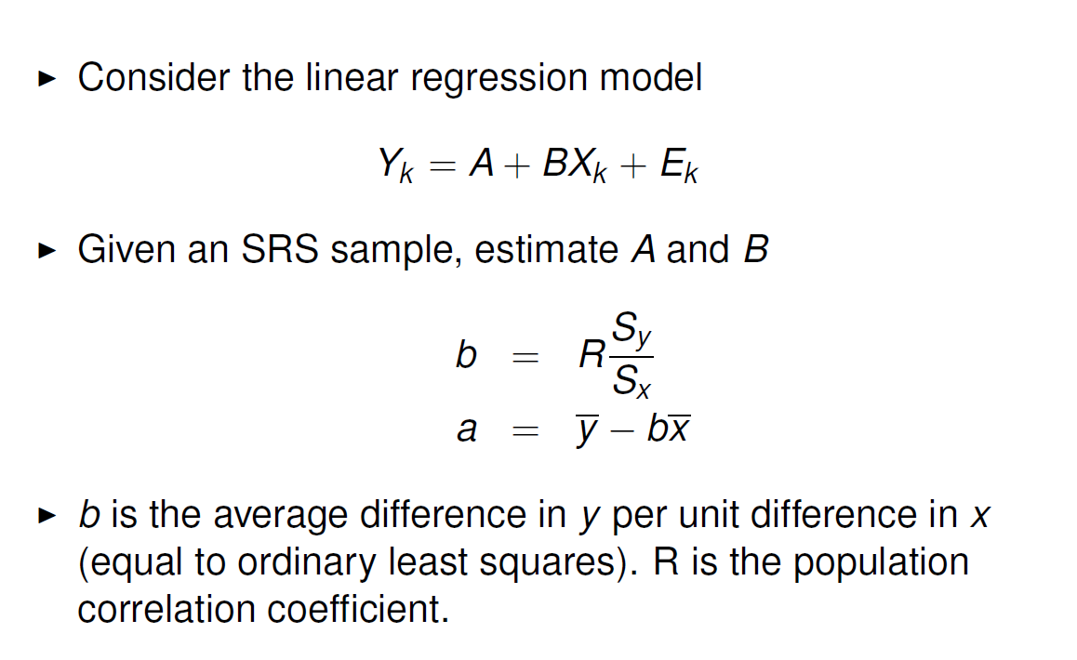
Descriptive Model in Survey Analysis

Slide 25
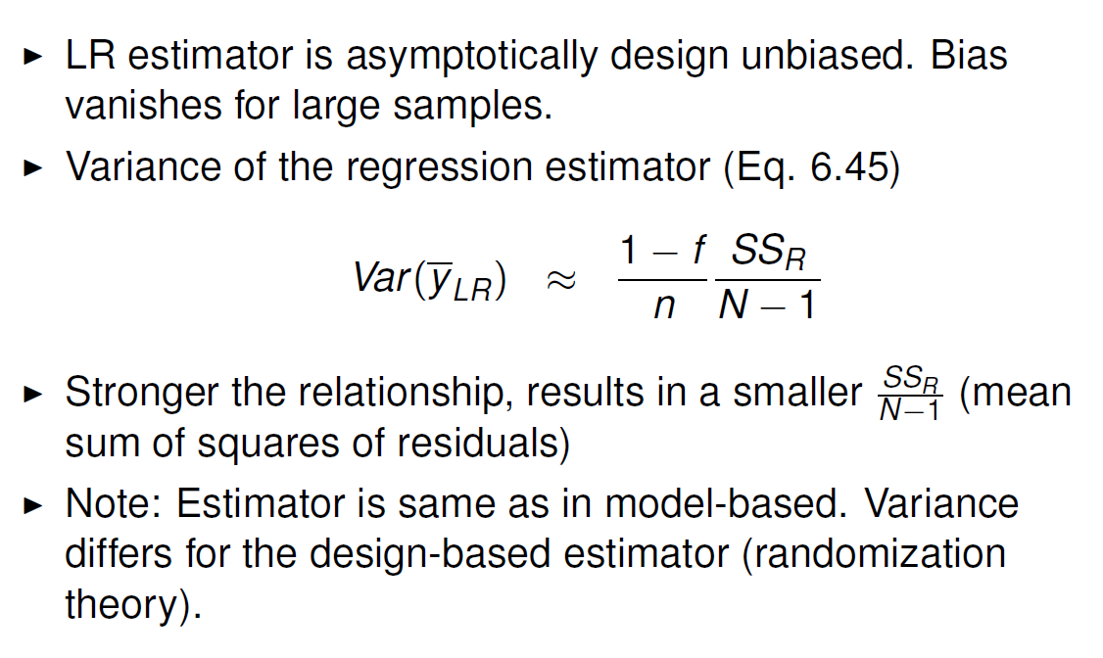
Descriptive Model in Survey Analysis

Slide 26
What to do if you don’t have a list…
Question:
“How many double espresso’s are being drunk at UU in a year?”
What kind of sampling design? Choose:
Design based
Ratio-estimation
Model-based

Slide 27
What to do if you don’t have a list…
Question: “How many double espresso’s are being drunk at UU in a year?”
Do a random sample, and ask a filter question
E.g. “Do you ever drink from the coffee machine?”
stratify -> oversample those more likely to drink coffee (e.g. employees )
Do an area sample
Estimate the ‘double espresso per person-day/ area’ -> ratio estimation
Use model-based estimation
Somehow find coffee drinkers
Find auxiliary variables that correlate with Y
Sleep per night, stress, hours at UU, having a coffee card.

Slide 28
When ratio vs. regression?
Ratio
‘double espresso per person-day/area’ -> total no. espressos
Size of area/no. of buildings -> people in a certain area
Turnover per company/no. of peppers -> total pepper production
Often, good frame information, and a meaningful 0
Regression
Happiness <- grades:gender:income:sociallife
Vote <- race:age:gender:education
Often, little good frame information, no meaningful 0

Slide 29
Class exercise 2
Regression estimation in practice
30 minutes

Slide 30
Extra slides
What goes right and wrong?

Slide 31
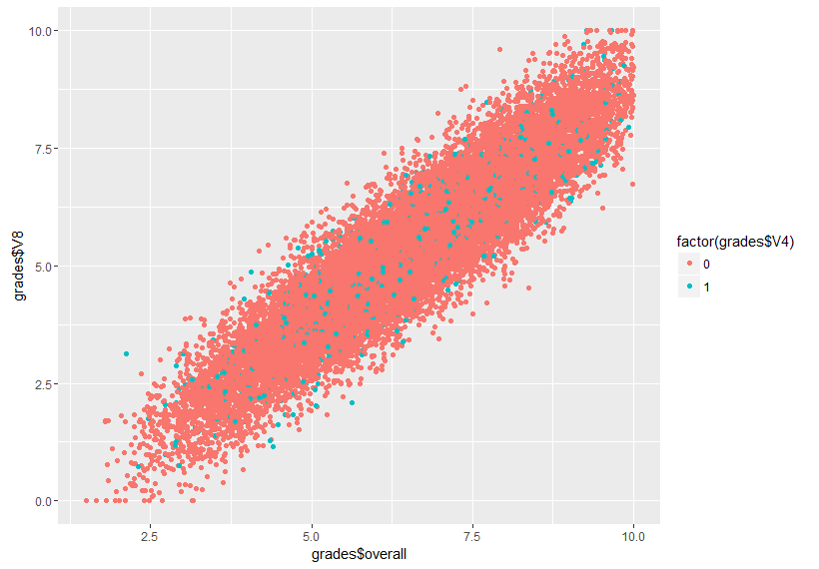
Model based sampling
Let’s bring student happiness in!
Population data:
- N=20000
X = grades
Y = student happiness (also 0-10 scale)
Mean happiness = 5.37

Slide 32
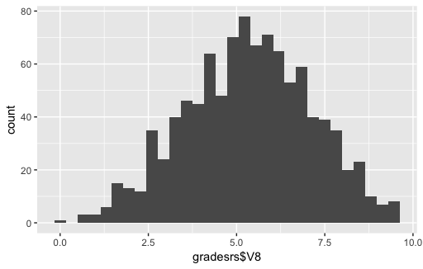
Simple Random Sampling
- Simple Random Sample
n=1000
Happiness (on X):
Mean = 5.32
S.e = .05477
CI: [5.21; 5.43]

Slide 33
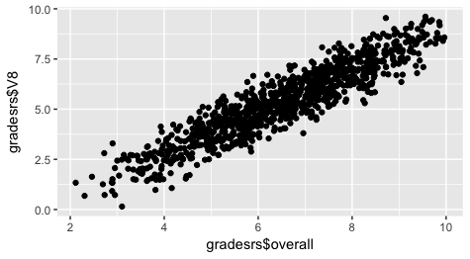
Ratio estimation under SRS
Svyratio(~happiness, ~grades, design = ratio.design)
B= .8231
s.e. = .0024
Predicted mean= 5.34
Or: summary(lm(happiness~0+grades,data=gradesrs, subset=(V4==1)))
Mean(data$fittedvalues )
B = .83
s.e. =.0036
Predicted mean = 5.42

Slide 34
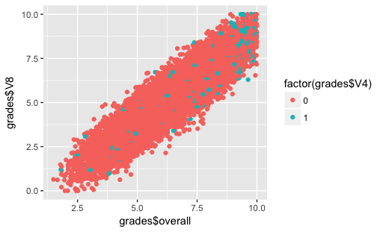
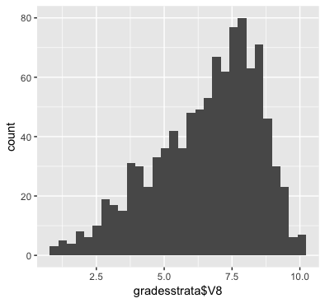
Oversample students who get good grades

Slide 35
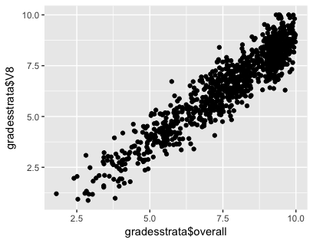
Oversampling students with good grades
Design based:
Mean = 5.33
S.e. = .0337
Ratio estimation
B=.87
S.e. = .0026
Mean= 5.335
Regression estimation
B = .83
S.e. = .0036
Mean=5.45

Slide 36
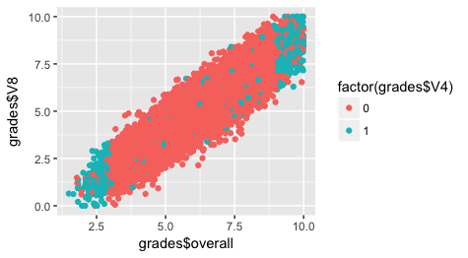
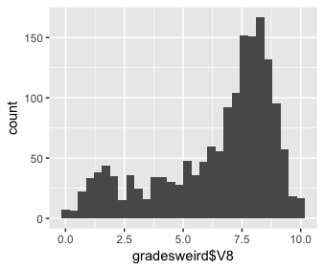
Truly model based – extreme cases

Slide 37
Truly model based – regression
Regression model:
Happiness <- grades + programme
(+ age, gender, etc.)

Slide 38
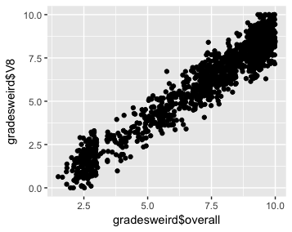
Truly model based
Design based
Mean = 5.33
S.e. = .0335
Ratio estimation
B=.87
S.e. = .0026
Mean= 5.33
Regression estimation
B = .87
S.e. = .0027
Mean=6.28

Slide 39
What works?
 | Type of sample | Mean | Precision | Mean square error
Design Based | SRS | 5.32 | .0548 | .05² + .05 = .0525
 | Oversample good students | 5.33 | .0337 | .04² + .03= .0353
 | Extreme cases | 5.33 | 0.335 | .04² + .03 = .0351
Ratio-estimation | SRS | 5.34 | .0027 | .03² + .0027 = .0036
 | Oversample good students | 5.335 | .0026 | .035² + .0026 = .0037
 | Extreme cases | 5.335 | .0026 | 035² + .0026 = .0037
Regression estimation | SRS | 5.42 | .0036 | .05² + .0036 = .0061
 | Oversample good students | 5.45 | .0027 | .08² + .0027= .0091
 | Extreme cases | 6.28 | .0036 | .93² + .0036 = .8685
Notes: Population mean = 5.37. MSE = bias + se²

Slide 40
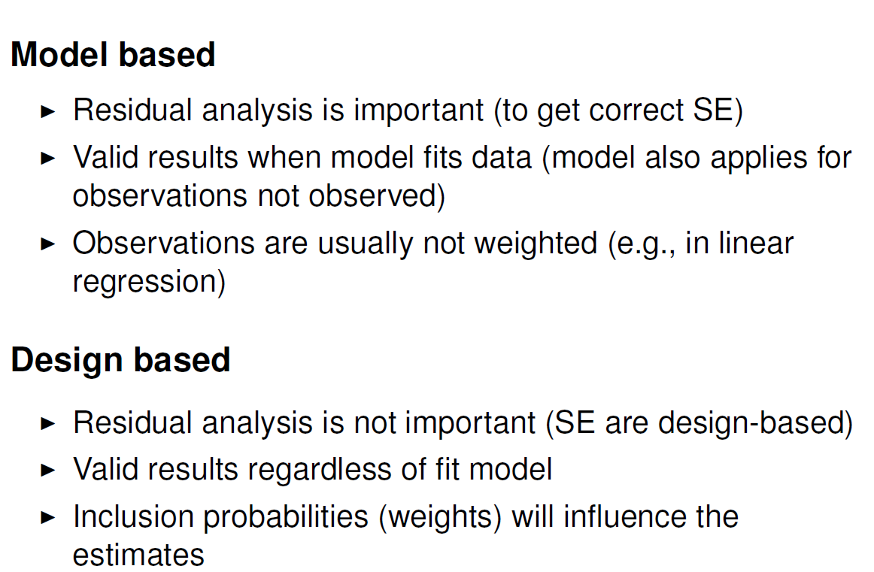
Design-based versus model-based

Slide 41
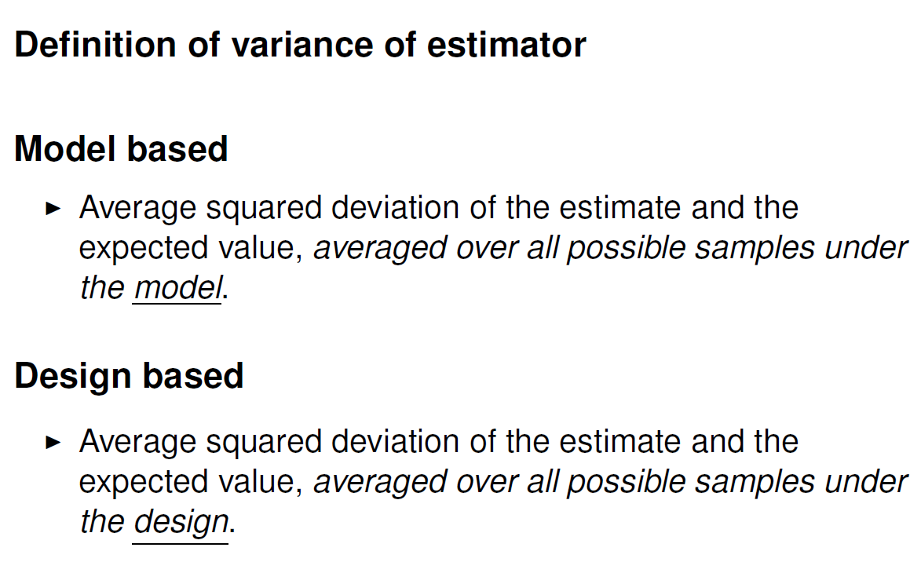
Design-based versus model-based

Slide 42
Implicationss of going model-based
Sampling is not so important!
We just get data, and as long as we are confident that our model is correct in the population, we are fine…
We need a good (regression) model for Y
We need to worry about sample <-> population
On a more conceptual level, not about inclusion probabilities
Sample should capture variation
Selection bias, nonresponse
From now on: more focus on model-based inference
Nonresponse model -> weights
Missing data model -> imputation
Selection bias model -> ???

Slide 43
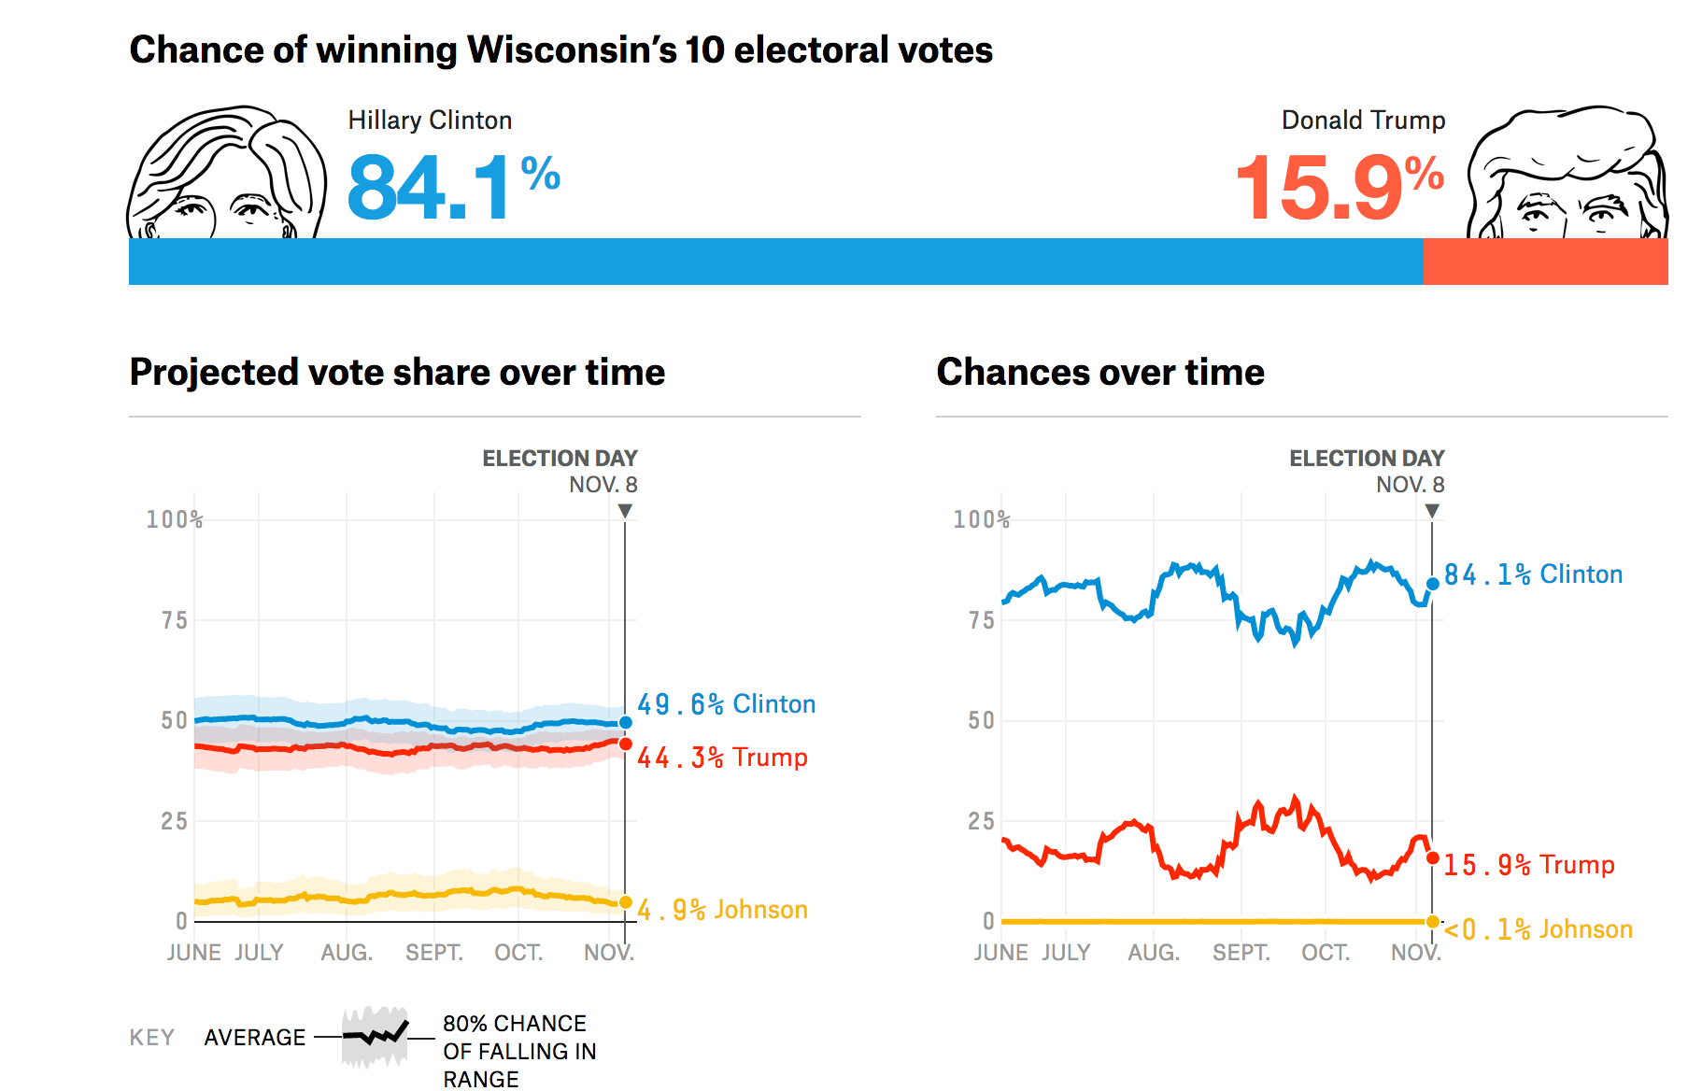
Model-based inference – an example
How did it end?
Notes:
Taken from https://projects.fivethirtyeight.com/2016-election-forecast/wisconsin/

Slide 44
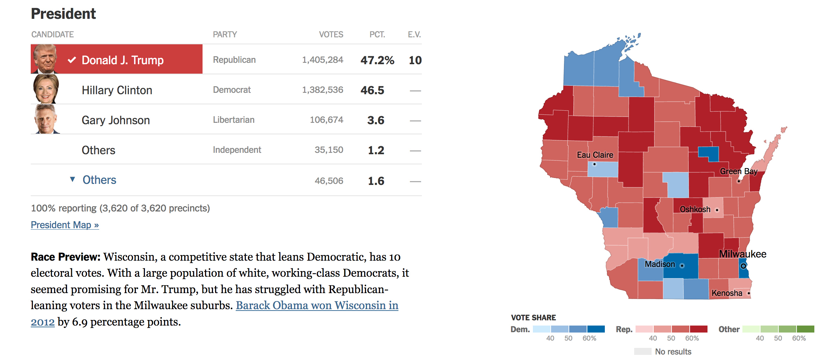
Wisconsin – Presidential election 2016
Notes:
From: https://www.nytimes.com/elections/results/wisconsin

Slide 45
Model-based inference – an example
If this were an individual poll of n=10000
s.e. =
= sqrt(.496(1-.596)/10000) = .005
Clinton Vote CI:
[.4904 - .5096]
Notes:
Taken from: https://projects.fivethirtyeight.com/2016-election-forecast/wisconsin/

Slide 46
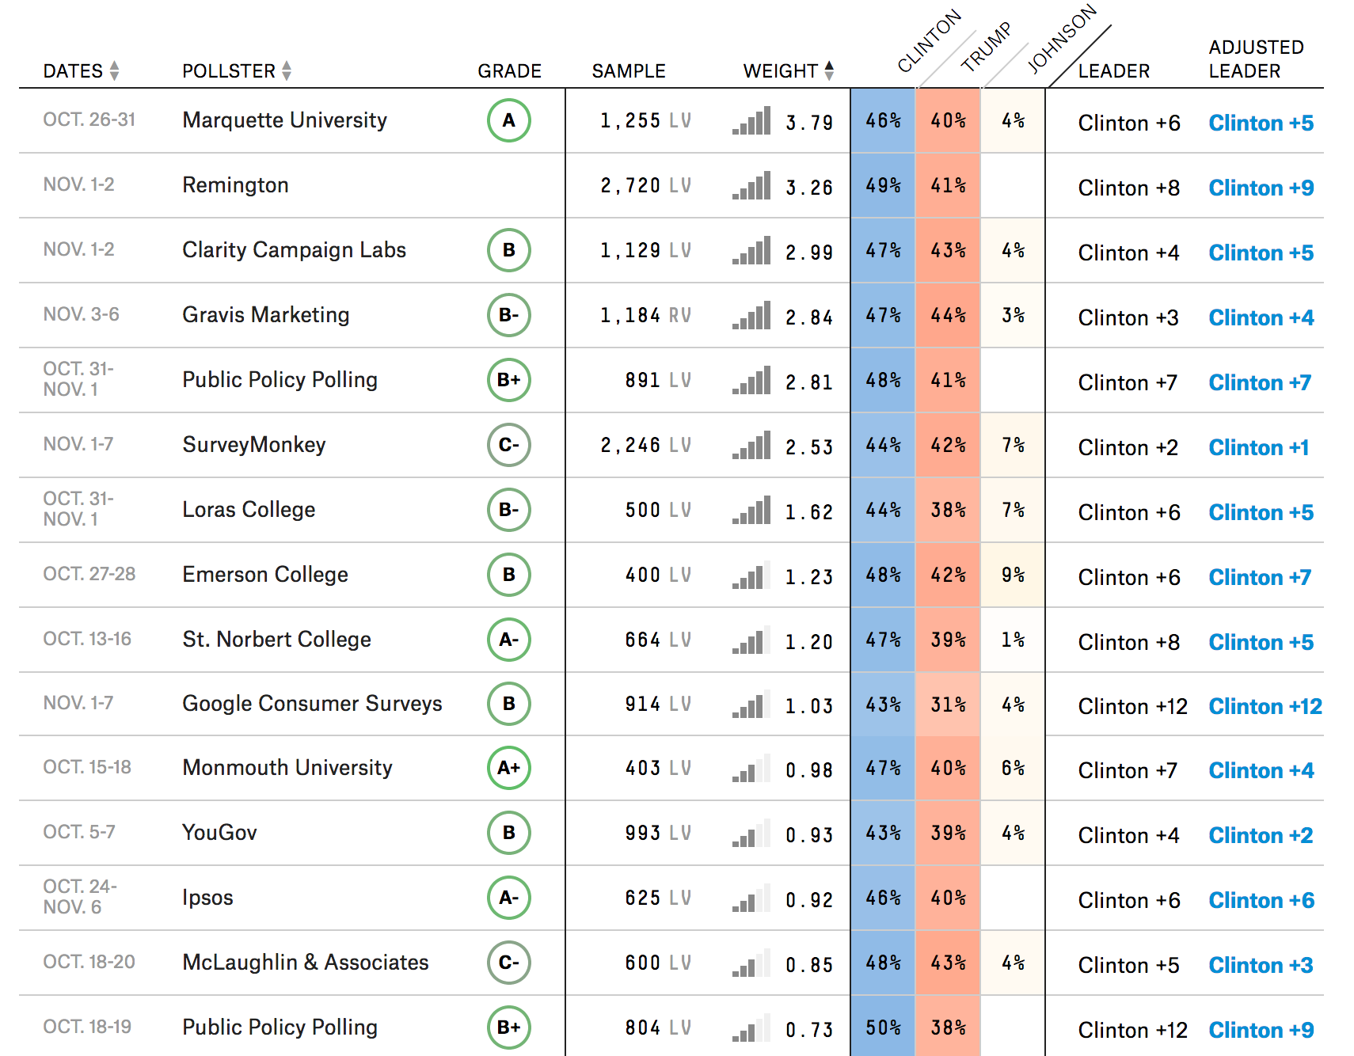
How does political polling in the USA work?
Multiple polls
Weighted by:
Quality of organisation (grade)
Recency
Results presented is aggregated total

Slide 47
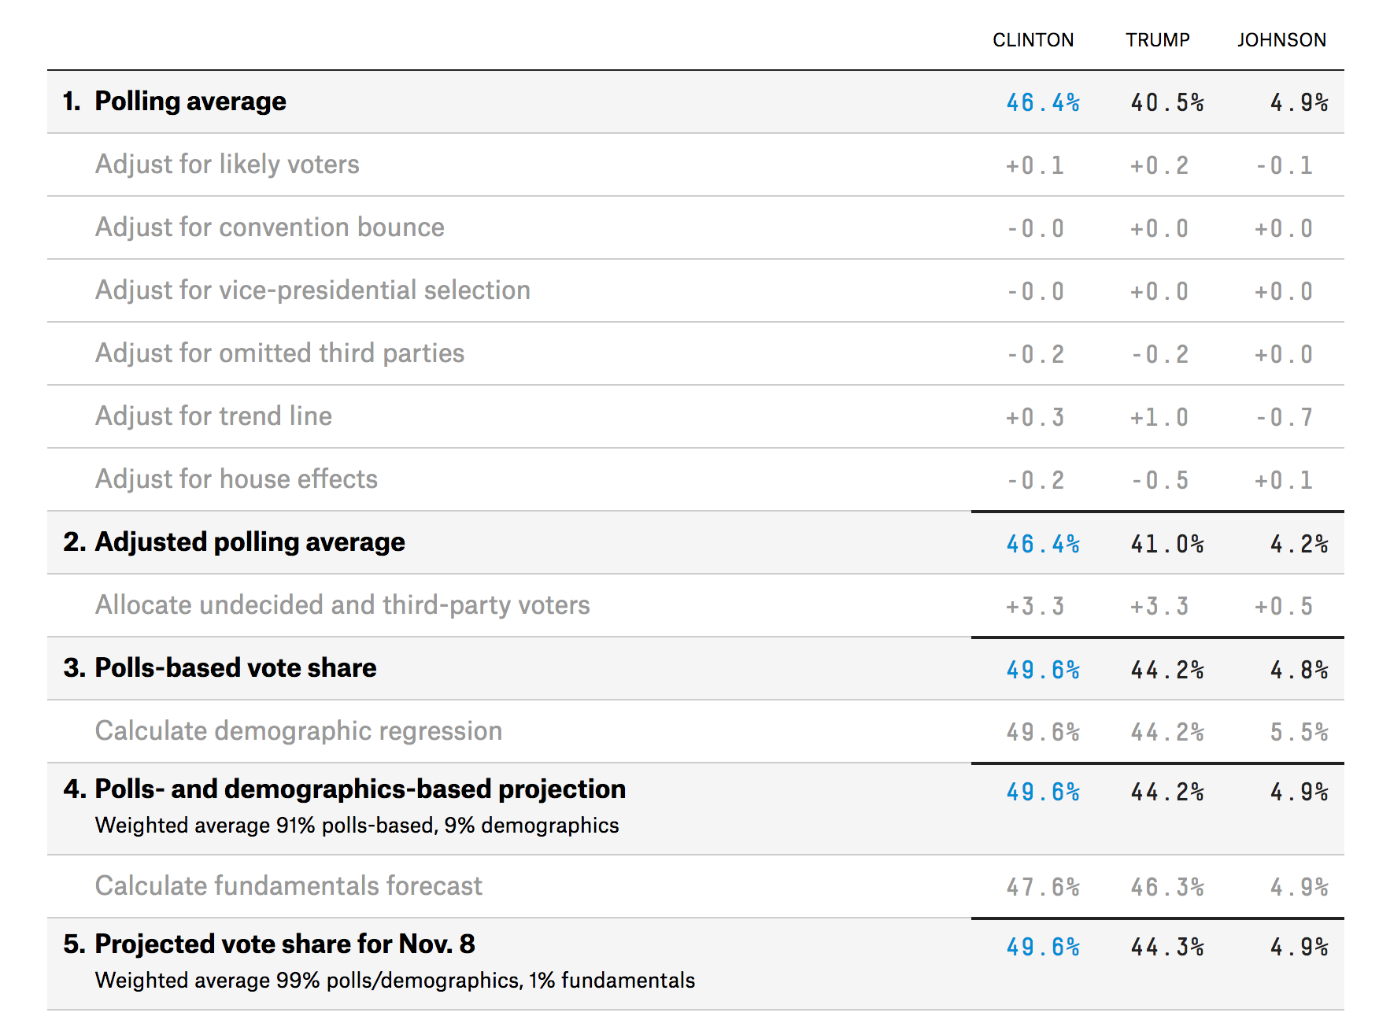
But forecasters do not stop there…
Adjustments for:
Likely voters
Not all people are likely to go and vote
Omitted third parties
Not all polls ask for all parties
Adjust for trend line
A smoothing adjustment to avoid large fluctuations
House effects
Some pollsters are known to have a bias
Notes:
Taken from: https://projects.fivethirtyeight.com/2016-election-forecast/wisconsin/

Slide 48
But forecasters do not stop there…
Adjustments for:
Undecideds
Assumption about how “don’t know” answers will vote
Notes:
Taken from: https://projects.fivethirtyeight.com/2016-election-forecast/wisconsin/

Slide 49
But forecasters do not stop there…
Demographic regression
Use data from other states:
Fit a model with demographics
(ethnicity, age, college degree, income)
What is predicted vote in Wisconsin?
Mix the poll outcome with model-based outcome
Notes:
Taken from: https://projects.fivethirtyeight.com/2016-election-forecast/wisconsin/

Slide 50
Why were the polls wrong?
It wasn’t all the modeling…..
Polls only: 46 vs. 40 – result: 46.5 vs. 47.2
+ modeling: 49 vs. 44
AAPOR report (Kennedy et al, 2017) – week 1
Shy Trump vote
Low turnout
Late swing to Trump
Failure to correct for overrepresentation of highly educated
Notes:
https://www.nytimes.com/2017/05/31/upshot/a-2016-review-why-key-state-polls-were-wrong-about-trump.html
http://www.aapor.org/Education-Resources/Reports/An-Evaluation-of-2016-Election-Polls-in-the-U-S.aspx

Slide 51
Why were the polls wrong?
Model based estimation depends on quality of model!
In design based, we can estimate error
In model-based -> much more difficult
Why not do design-based inference?
Costs
Time
Problems with coverage, nonresponse
-> still needs modeling
There are too many people who want to do a a poll
100s in Wisconsin alone
Notes:
https://www.nytimes.com/2017/05/31/upshot/a-2016-review-why-key-state-polls-were-wrong-about-trump.html
http://www.aapor.org/Education-Resources/Reports/An-Evaluation-of-2016-Election-Polls-in-the-U-S.aspx

Slide 52
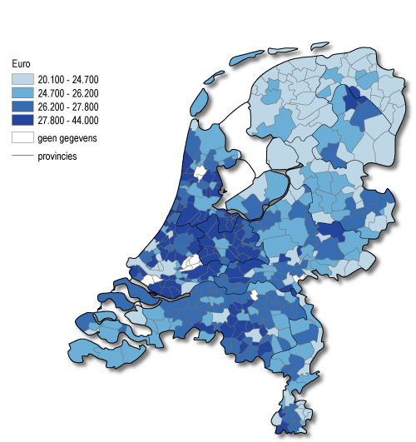
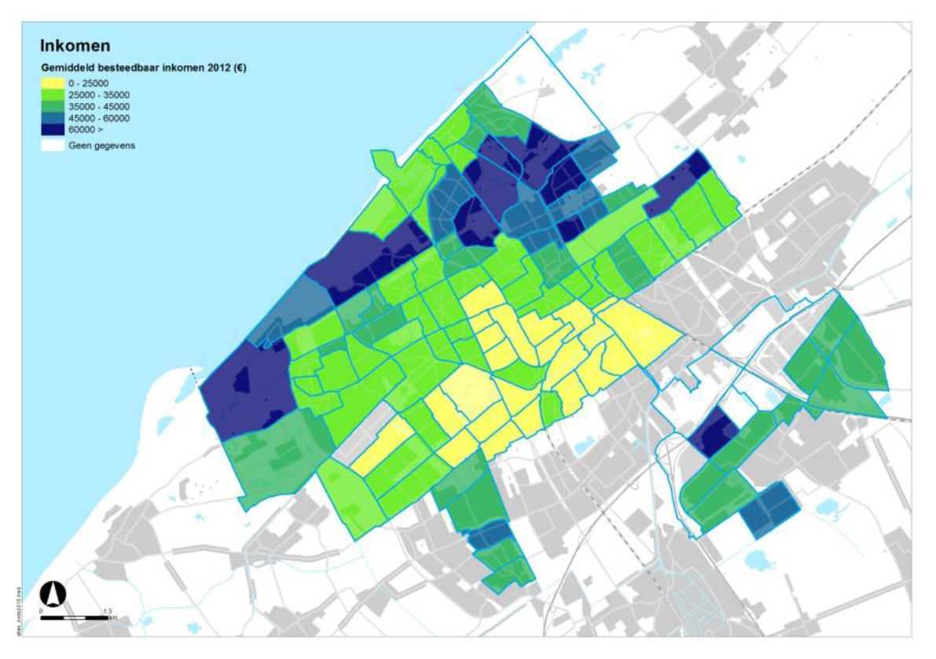
What is a cluster?
What size should be a cluster be?

Slide 53
Small Area Estimation
Desire for detailed statistics at low geographical level.
Would result in 1000s clusters in Netherlands, even more in Europe
Solution: Small area estimation
Analogue to coffee machines example
There are 100s of machines at UU
Build an elaborate model with many
auxiliary variables
Predict Y in every cluster by using a model

Slide 54
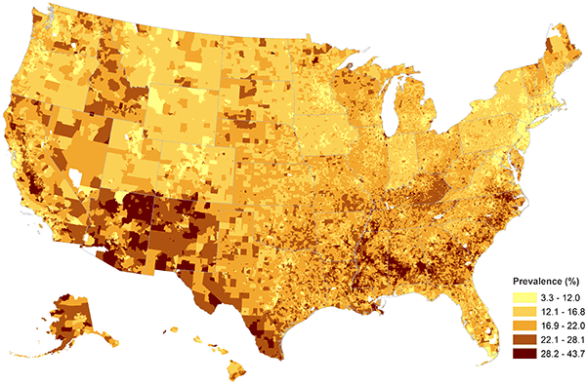
Example
Childhood obesity
Used 91,642 completed interviews from NCSH survey:
Model for every county:
NSCH child obesity status (yes or no) = sex + age + race (individual level)
+ median household income + lifestyle classifications + urbanization levels (zip-code level)
+ median household income + urban-rural (county-level)
+ random effects (state- and county-levels)

Slide 55
Your data and svysettings
How do I know whether it works
How can I check what my weights mean?
What should ~fpc be? (esp. with use of weights)

Slide 56
Next week(s)
Next week: class free
Finish regression exercise
Catch up on reading
In two weeks: nonresponse
Readings: several articles
In two weeks: assignment 1 (!)

